Slide 1
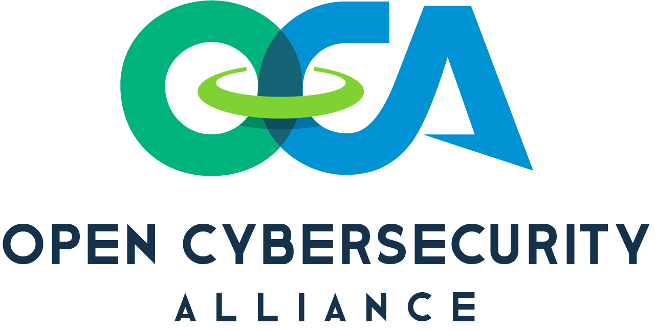
The State of Security and OCA
OCA Workstreams and Progress
New Projects
Questions

Slide 2

Today’s state of security
Explosion of security innovation and products
Increasing mountain of valuable data and insights
Increased complexity
25 to 49 different security tools from up to 10 different vendors (ESG 2019)
Integrating security products
Resource intensive
Time-consuming
Expensive
Notes:
[Anshul] The rapidly evolving Cybersecurity threat landscape has driven an explosion of security innovation and products generating an increasing mountain of valuable data and insights but also increased complexity to make sense of it all.
On average organizations are using 25 to 49 different security tools from up to 10 different vendors, each of which generate an explosion of data & insights. (ESG 2019)
Today, integrating security products into an established operational environment can be a resource intensive, time-consuming, and expensive effort to fully accomplish.

Slide 3




Challenges & Implications
Unable to break down silos to extract full value from tools
Lost broader value and insights from existing products
Lack out-of-the-box integration capability
Facilitate communication
Blocking threats
Automation
Policy changes
Time on interoperability versus addressing security threats and risks
Notes:
[Anshul. Ask a transition question]
Unable to break down silos to extract full value from tools
Cubroader value and insights from existing products
Lack of robust out-of-the-box integration capability to facilitate communication, blocking threats, automation, and policy changes.
Time spent focusing on interoperability is time not spent addressing security threats and risks
Untapped security value of data in existing security and infrastructure products.
Solving security and compliance challenges requires broad insight across cloud, SaaS, on premise based solutions solutions that assume a starting point of “first, put 100% of your data here” are not implementable
Q: But why open source? Why this approach?

Slide 4
OCA
Global like-minded cybersecurity vendors, end users, thought leaders & individuals
Who
Open Cyber Security Ecosystem
Products freely exchange info, insights, analytics & orchestrated response
Vision
Open
Commonly developed code & tooling
Mutually agreed upon technologies, standards & procedures
How
Notes:
[JK]
The Open Cybersecurity Alliance (OCA) Project will be comprised of global like-minded cybersecurity vendors, end users, thought leaders and individuals who are interested in fostering an open cybersecurity ecosystem, where products from all vendors and software publishers can freely exchange information, insights, analytics, and orchestrated response, via commonly developed code and tooling, using mutually agreed upon technologies, standards, and procedures.
While all of us work hard on interoperability today, we believe we can do much more to create solutions that are more effective at sharing the full depth of insights out-of-the-box, allowing organizations to focus more on security effectiveness.
TEAM SPORT!

Slide 5




Open Cybersecurity Alliance Goals
Develop and promote sets of open source common code, tooling, patterns, and practices for sharing data among cybersecurity tools
Enable vendors who make use of OCA code, tooling, and patterns to seamlessly interoperate
Integrate once, reuse everywhere
Facilitate a variety of
security use cases:
Threat hunting & detection
Analytics
Operations
Response
…and more
Notes:
[JK. Anshul to ask transition question.]

Slide 6
Benefits of Open Cybersecurity Alliance
For Organizations
Discover new critical insights and findings, that would have otherwise been missed
Reduce unnecessary procurement of new tools
Reduce vendor lock-in
For Security Vendors
Reduce data integration expenses; improve focus on higher-value features & integrations
Improve robustness of data integrations; allow your client to extract more value from your tools
For Individuals
No membership required - pick an interest and join a group, begin collaborating, learn new things
Help define a standard, improve security for the world and leave a legacy
Notes:
[DARREN] - Do we want to keep the question mark in this header?

Slide 7
OASIS Open Projects support shared community development of code, APIs, standards, reference implementations…
In one place, under open source licenses with a path to recognition in international policy and procurement.
Notes:
OASIS is very excited to serve as the home of the Open Cybersecurity Alliance.

Slide 8



















OCA Sponsors
Notes:
[DARREN]

Slide 9

Open Cybersecurity Alliance - Projects & Workstreams
Founding Project
Working Group
New Project
STIX Shifter
OCA Ontology
SCAPv2 Prototype
Security data federation and normalization
Common & aligned formats for APIs and communication
Next generation of collection of posture, compliance, vulnerability information
Architecture Working Group
IOB Sharing Working Group
Kestrel Threat Hunting
Unified reference architecture for security operations
Collaboration on next generation of behavioural detection
Universal cross-product threat hunting language
Notes:
[JK. Anshul to ask transition question.]

Slide 10

STIX Shifter Federated, universal data access
Open source python library
Connect to products that house data repositories with STIX Patterning
Transforming into STIX Observations
Return STIX 2 JSON format
Bridge to a new data source
19+ existing connectors, more continuously added
Highly active - 120 Forks, 105 Stars
Benefits
Comprehensive bilateral connection
Query multiple products quickly producing unified results
Scales with Complex queries that span domains of network, file, and logs
Connectors available as part of open source project
SIEMs
Data Ponds
Endpoint Data
Threat Data
IT & App Data

Slide 11




OCA Ontology
Open, interoperable cybersecurity messaging format
Categorized set of messages used to perform actions and/or notify
Other common open standards for message content (OpenC2, STIX, etc.)
Sample code on how to integrate the ontology into existing security products and related solutions

Slide 12
SCAP Data Collection Architecture Prototype
Goal 1 – Experiment and validate designs before codified in an architectural standard
Goal 2 – Provide a reference implementation supporting testing of compliant vendor products
Currently, code supports dummy message flows through the architecture supporting key use cases
We are fleshing out specific details of this exchange based on needs to test design proposals
We hope we can get more eyes on the design and hands on the code going forward
© 2020 The MITRE Corporation. All Rights Reserved.
Approved for Public Release; Distribution Unlimited. Case Number 18-4154

Slide 13






Architecture Working Group
Workgroup Goals:
Leverage the diverse stakeholder base of the OCA to unify otherwise disparate cybersecurity architecture & standards efforts
Work among and between standards bodies to create a more holistic and realistic view of cyber security operations that bridges the silos
Example: NSA, NIST, and CIS are all collaborating to make posture collection a reality under OCA
Workgroup Outputs:
OCA Solution Brief
OCA Reference Architecture Diagrams (WIP)
OCA Reference Architecture - White Paper (WIP)
SACM
SCAPv2

Slide 14
IOB Sharing Working Group
With IOCs: Any of these could be benign:
Loading a DLL
Calling out (DGA perhaps not)
Pulling a file
Change of privilege
Lateral communication
Problem Statement:
The IOC way depends on identifying one or more of these and a lot of searching to see the attack
IOB would find the whole story as a chain
Following the SolarWinds announcement, an IOB would have helped immediately to find this
Workgroup Goals:
A description capability that can be used to share behavioural sequences to be found [{behavior A} + {behavior B} near {behavior C}]
Share-able, vendor neutral
Can be tied to MITRE ATT&CK as it will map to movement through the matrix (Tactics and Techniques)
Use existing capabilities where they exist, collaborate & innovate where not

Slide 15
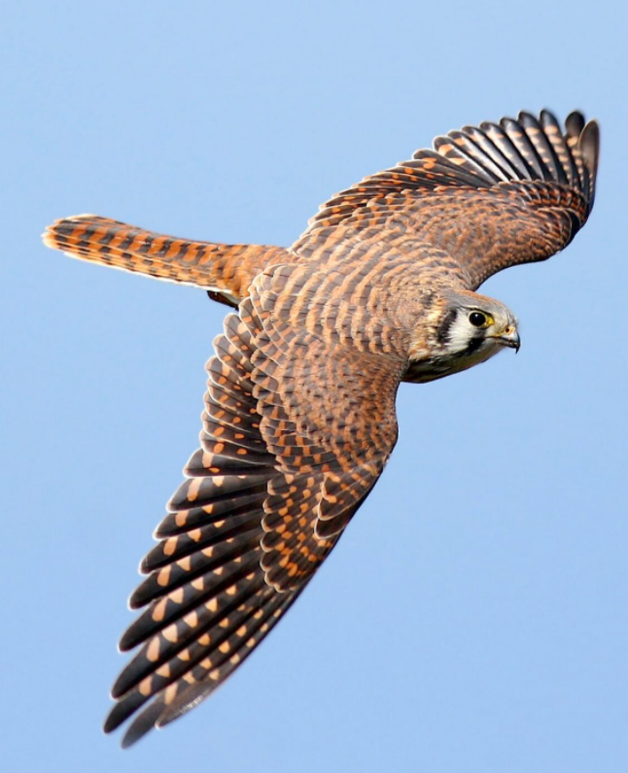
Introducing Kestrel
The Threat Hunting Language
April 2021

Slide 16
Kestrel Benefits
Enable Threat hunters to focus on WHAT to hunt, and let Kestrel take care of the How to Hunt
Threat Hunters
Discover and analyze threat faster
Foster collaboration and re-use of threat TTPs
Unified language across all data sources
Machine Learning & Analytics
VALUE CREATED
TIME SPENT
What is the threat hypothesis?
How to query this EDR?
What is the next step?
WHAT
to hunt?
HOW
to hunt?
How to extract the field?
What TI to add?
How to enrich this data?
What ML model to fit?
How to plug in this ML model?
Notes:
Kestrel enables threat hunters to perform cyber reasoning and threat discovery much faster and easier by providing a simple, composable, and interactive way to encode, share and reuse hunting knowledge into hunt-flows to develop and then confirm threat analysis.
Reduce time to detect breaches and root cause
Composable TH procedure across analysts
Unified language across data sources
Reusable, shareable hunting flows and analytics
Express threat intelligence knowledge (TTPs in MITRE) as attack patterns
Access security tools to collect relevant logs and events for threat analysis
Establish relationships between attack patterns and observed data for cyber reasoning
Run the pattern and analytics against to observed data to identify matches
Collaborate with other hunters to share findings and threat hunting techniques

Slide 17







Language Design to Focus on Expressing The What
What's interesting?
Service running
nginx = GET process WHERE name = 'nginx'
What's the suspicious-ness?
Knowledge
What's suspicious?
Known TTPs
express
procs = APPLY susp ON procs
exploited_nodejs = GET process
WHERE parent.name = 'node' AND binary != 'node'
What's the likelihood?
What's connected?
Relation resolution
nt_new = APPLY exfil_ana ON nt
Pattern
Analytics
chilprocs = FIND process CREATED BY exploited_nodejs
compose
What's the look?
APPLY viz_traffic ON nt_new
What's related?
Referrable search
similar_nettraf = GET network-traffic
WHERE src.ip = exist_nettraf.src.ip
AND dst.ip = exist_nettraf.dst.ip
Hunt Flow
execute
Data
‹#›

Slide 18
A Simple Threat Hunting Example MS Office launching power-shell, cmd, wmic or cscript
Crowd Strike
event_simpleName=ProcessRollup2 (FileName=node.js OR FileName=nginx OR FileName=apache)
| dedup aid TargetProcessId_decimal
| rename FileName as Parent
| rename CommandLine as ParentCmd
| table TargetProcessId_decimal Parent ParentCmd
| join max=0 TargetProcessId_decimal
[ search event_simpleName=ProcessRollup2 FileName=bash
OR FileName=zsh
OR FileName=csh
OR FileName=sh
| rename ParentProcessId_decimal as TargetProcessId_decimal
| rename MD5HashData as MD5
| rename FilePath as ChildPath
| dedup TargetProcessId_decimal MD5
| fields TargetProcessId_decimal FileName CommandLine ]
| table Parent ParentCmd FileName CommandLine
Carbon Black
MS Office
And then, do it all again
( ( parent_name:winword.exe OR
parent_name:outlook.exe OR
parent_name:excel.exe
) AND
( process_name:powershell.exe OR
process_name:cmd.exe OR
process_name:wmic.exe OR
process_name:cscript.exe
)
)
fork
Threat Hunter needs to
Understand this Threat TTP
Determine relevant EDR
Obtain access to Carbon Black
Learn Carbon Black’s APIs
Learn how to script these APIs
Convert return data to usable format
Python scripts to automate the hunt
Kestrel
GET process FROM myEDR WHERE [process:name IN ('powershell.exe', 'cmd.exe', 'wmic.exe', 'cscript.exe')
AND process:parent.name IN ('winword.exe', 'outlook.exe', 'excel.exe')]
Simple yet powerful language, tailored for hunting
Unified across all environment and tools
Shareable framework to accelerate knowledge sharing and re-use hunts
Extensible with external ML and analytics

Slide 19
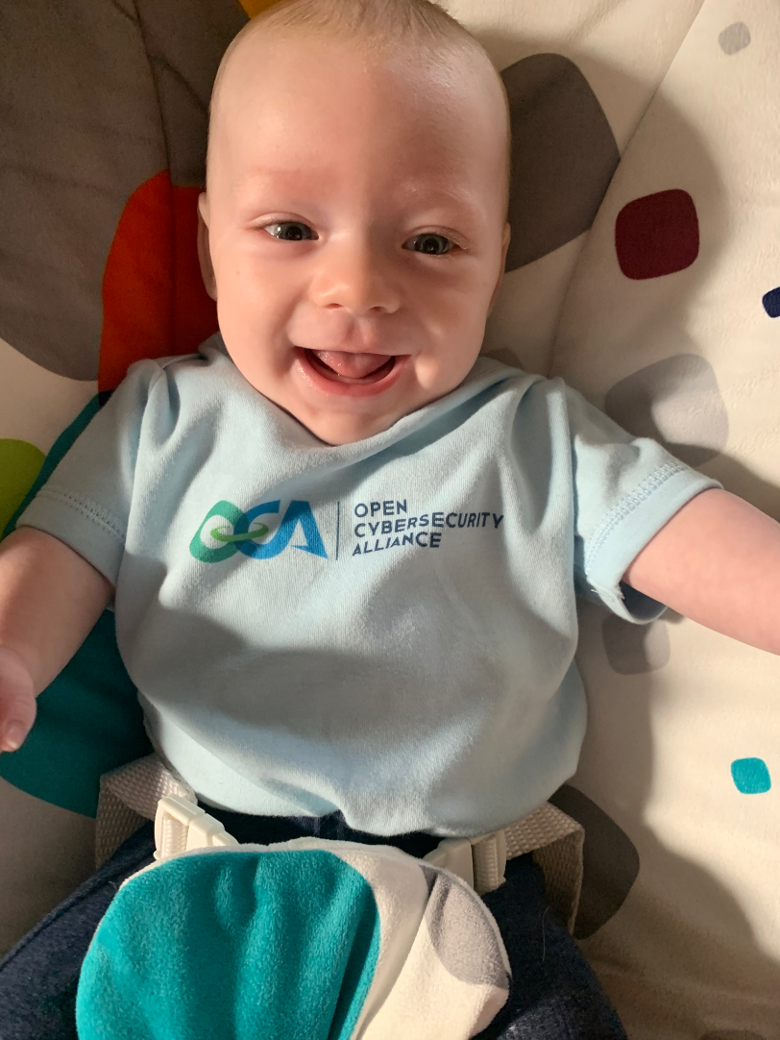
Get involved!
Everyone is welcome to participate in the Open Cybersecurity Alliance.
Individuals can make technical contributions to OCA repositories via GitHub.
Organizations can become OCA Sponsors. Gain a seat on the OCA Project Governance Board.
Receive special recognition and promotional benefits
.
Contact communications@oasis-open.org for more info
Join the Slack Channel and get involved!
Visit the website opencybersecurityalliance.org
Notes:
[DARREN]

Slide 20
Thank You.
Notes:
[DEE FACILITATES Q&A]
Seed Questions :
How do you as a systems integrator encourage vendors to embrace open architectures and solutions?
Where can i find stixshifter and opendxl ontology to use in my projects?
If I have a project idea I would like to contribute how do I go about it?
How does the OCA interface or indeed compete with existing standards, such as OpenC2, STIX/TAXII etc
What if I work for a company that existing members may be considered competitive, would my company be prevented from joining the OCA by existing members?
If my company cannot join the OCA can I still contribute as an individual?
How is this alliance different from others.
We’ve seen this before, nothing comes out.
How do Open projects work?

